Slide 1
The path to Hothouse Earth
What’s Hothouse Earth? (and what’s Icehouse Earth?)
The distinction between tipping elements and tipping points
Tipping points to Hothouse Earth

Slide 2

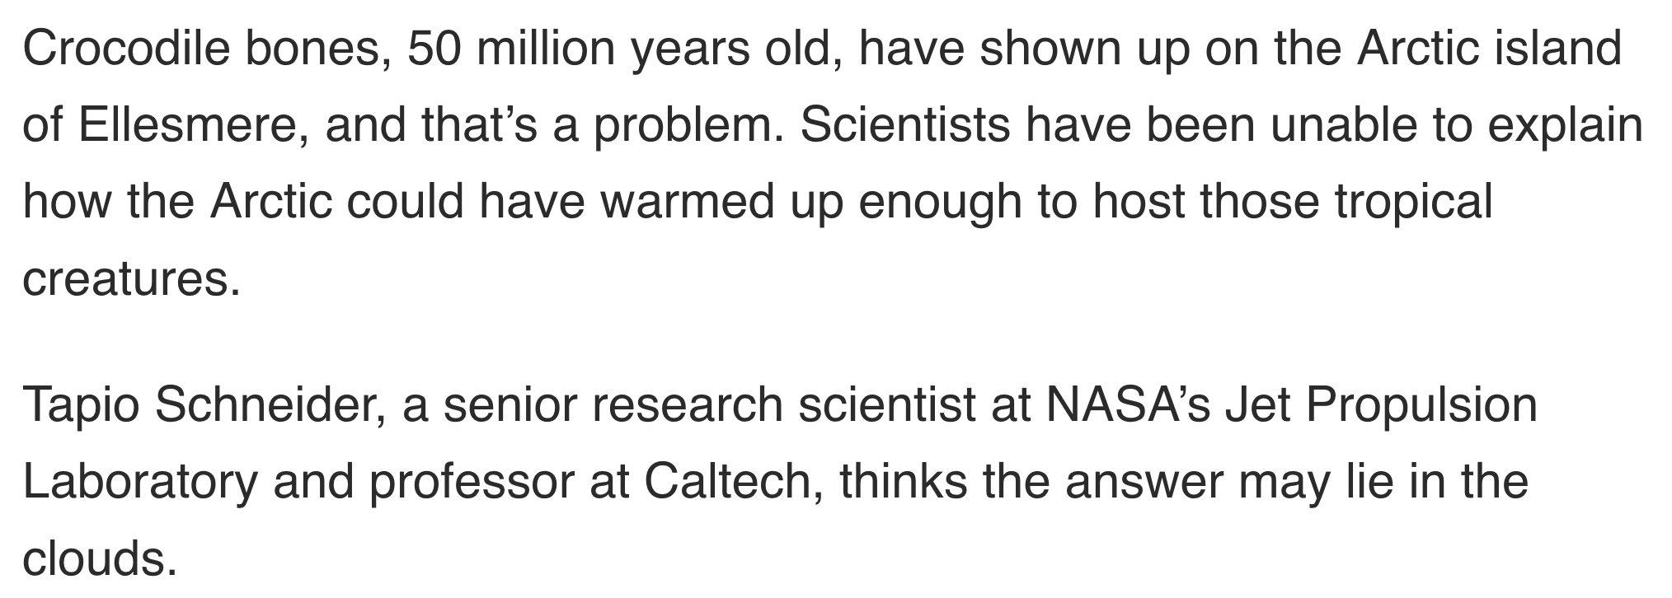
Hothouse Earth vs Icehouse Earth
https://climate.nasa.gov/news/2936/clouds-arctic-crocodiles-and-a-new-climate-model/

Slide 3
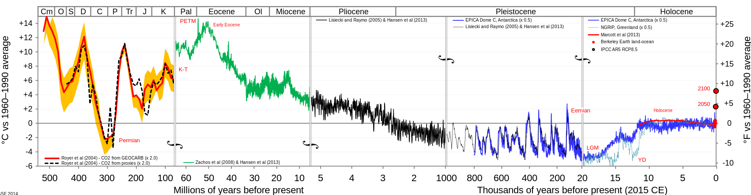
55 million years ago, Hothouse Earth
Past Present
Hothouse Earth
Icehouse Earth

Slide 4
Then, collision of India with Asia
Past Present
Hothouse Earth
Icehouse Earth
Collision video

Slide 5
Potential sea level changes due to changes in the cryosphere
time
Greenland ice sheet forms
Hothouse Earth
Icehouse Earth
Permanent ice in East Antarctic forms
65 meter drop in sea level
+/- 110 meters during “ice ages” (but we’re already at +110 b/c we’re in an interglacial

Slide 6
Potential sea level changes due to changes in the cryosphere
time
Greenland ice sheet “melts”
Hothouse Earth
Icehouse Earth
Permanent ice in East Antarctic “melts”
65 meter rise in sea level
+/- 110 meters during “ice ages” (but we’re already at +110 b/c we’re in an interglacial

Slide 7
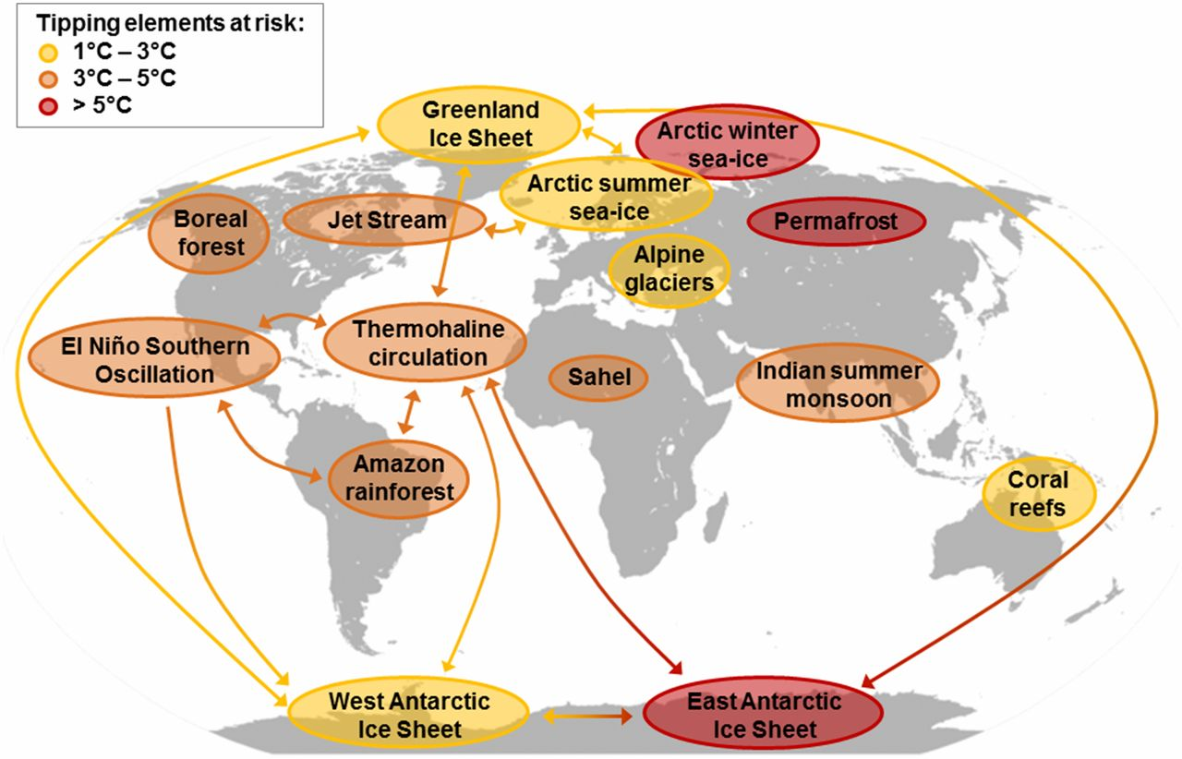
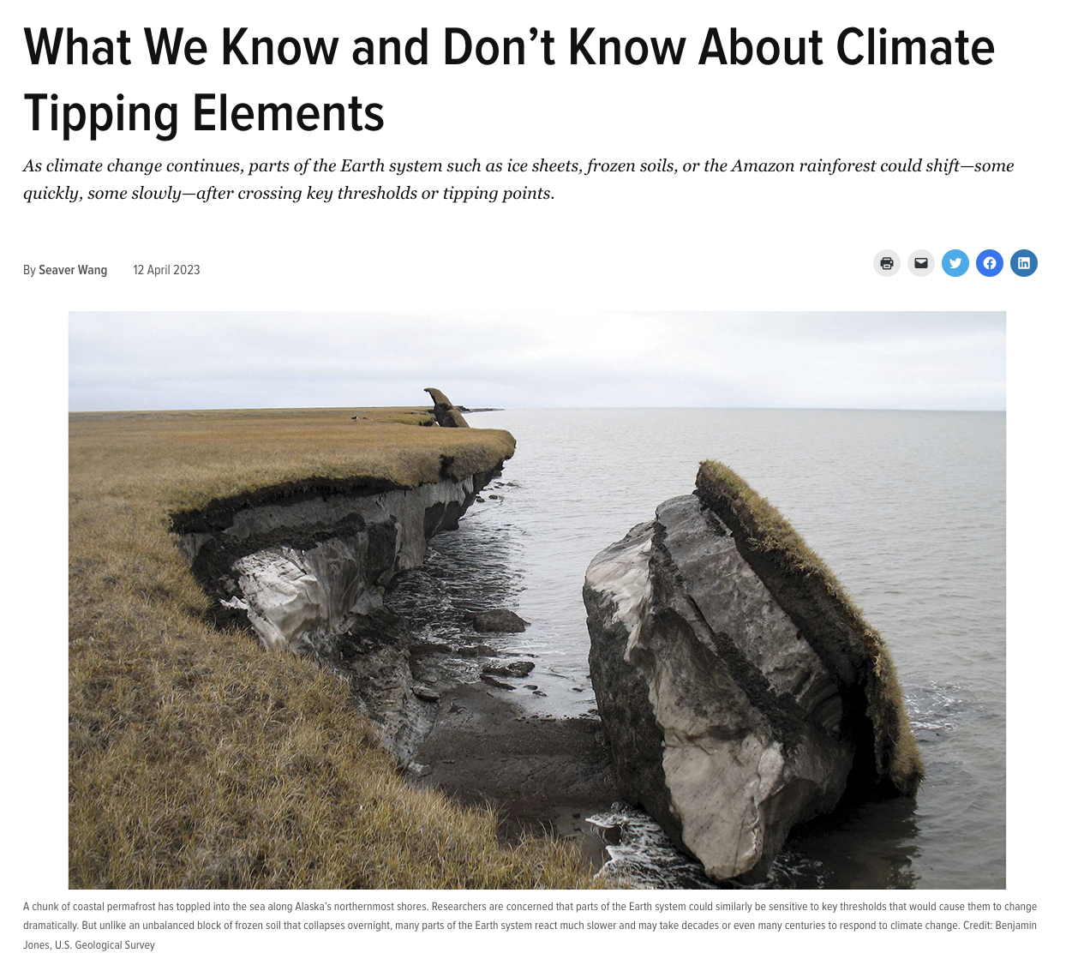
The distinction between tipping elements and tipping points
A tipping element is a feedback mechanism. We probably don’t know about all of them.
A tipping point is the temperature at which that mechanism will kick in, so we should keep warming below those values. IPCC scientists are saying we need to keep below 2.0 degrees warming to stay safe, but the fact is, we don’t really know.

Slide 8
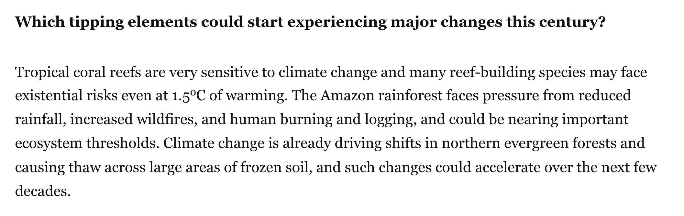
The distinction between tipping elements and tipping points
A tipping element is a feedback mechanism. We probably don’t know about all of them.
A tipping point is the temperature at which that mechanism will kick in, so we should keep warming below those values. IPCC scientists are saying we need to keep below 2.0 degrees warming to stay safe, but the fact is, we don’t really know.

Slide 9
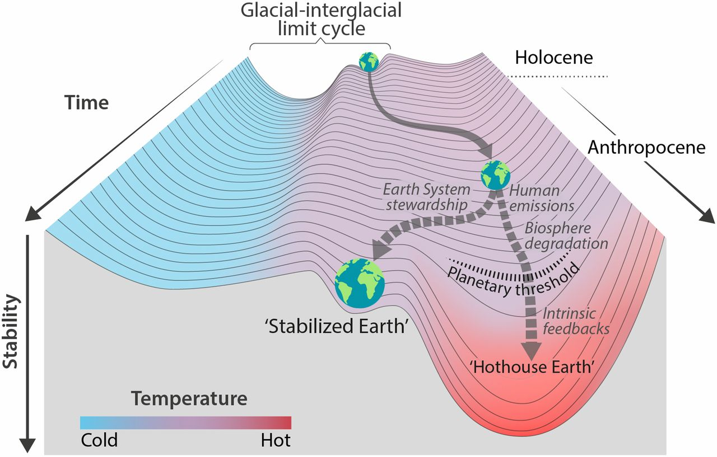
Tipping points to hothouse Earth
In 2023, we’re at +1.2 degrees relative to pre-industrial times
+1.5 degrees relative to pre-industrial times has been called “safe”
Nobody knows:
What the threshold is
How long it might take to make the transition to Hothouse Earth
*
Steffen et al, PNAS 2018: https://www.pnas.org/content/115/33/8252

